Slide 1

Machine Learning and Scikit-Learn
Andreas Mueller (NYU Center for Data Science, scikit-learn)
http://bit.ly/skCUNY
http://bit.ly/skCUNY

Slide 2



Me

Slide 3
What is scikit-learn?

Slide 4
Classification
Regression
Clustering
Semi-Supervised Learning
Feature Selection
Feature Extraction
Manifold Learning
Dimensionality Reduction
Kernel Approximation
Hyperparameter Optimization
Evaluation Metrics
Out-of-core learning
…...

Slide 5








1800+ research papers

Slide 6
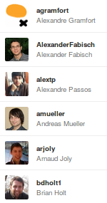
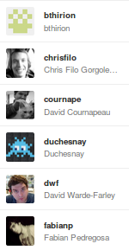
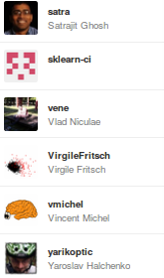
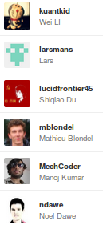
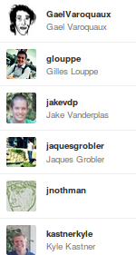
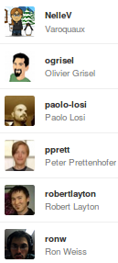

Slide 7
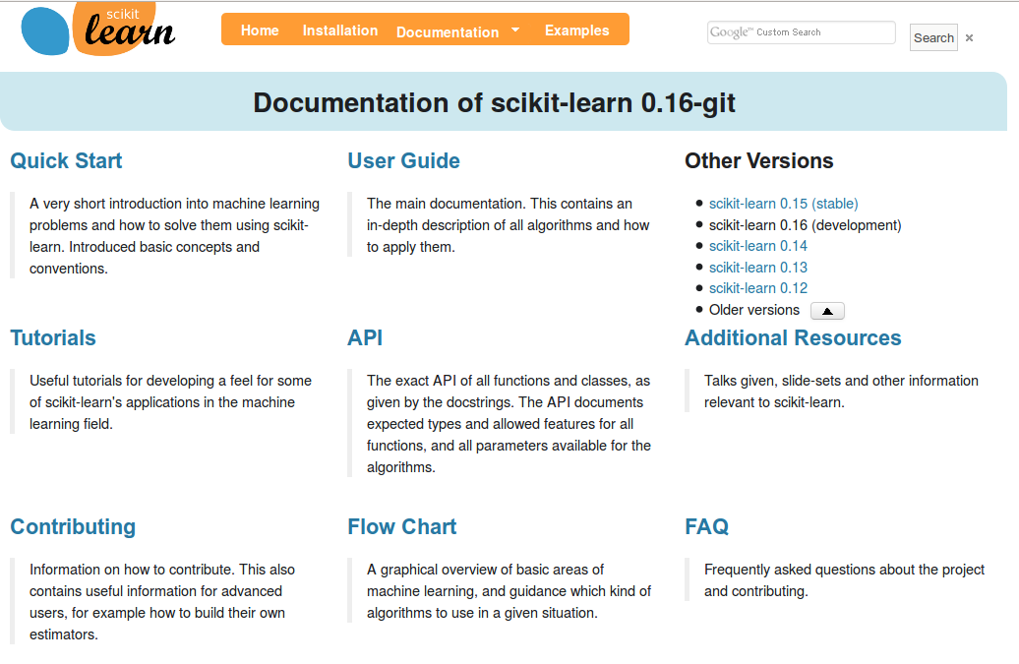
http://scikit-learn.org/

Slide 8
What is machine learning?

Slide 9
Hi Andy,
I just received an email from the first tutorial speaker, presenting right before you, saying he's ill and won't be able to make it.
I know you have already committed yourself to two presentations, but is there anyway you could increase your tutorial time slot, maybe just offer time to try out what you've taught? Otherwise I have to do some kind of modern dance interpretation of Python in data :-)
-Leah
Hi Andreas,
I am very interested in your Machine Learning background. I work for X Recruiting who have been engaged by Z, a worldwide leading supplier of Y. We are expanding the core engineering team and we are looking for really passionate engineers who want to create their own story and help millions of people.
Can we find a time for a call to chat for a few minutes about this?
Thanks

Slide 10
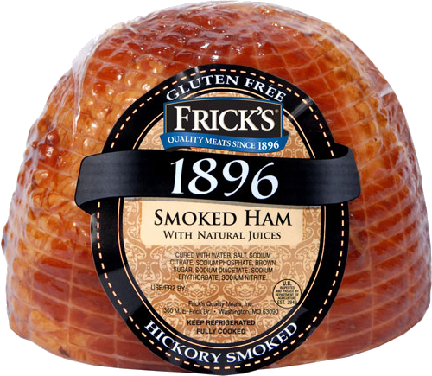
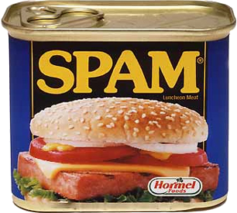
Hi Andy,
I just received an email from the first tutorial speaker, presenting right before you, saying he's ill and won't be able to make it.
I know you have already committed yourself to two presentations, but is there anyway you could increase your tutorial time slot, maybe just offer time to try out what you've taught? Otherwise I have to do some kind of modern dance interpretation of Python in data :-)
-Leah
Hi Andreas,
I am very interested in your Machine Learning background. I work for X Recruiting who have been engaged by Z, a worldwide leading supplier of Y. We are expanding the core engineering team and we are looking for really passionate engineers who want to create their own story and help millions of people.
Can we find a time for a call to chat for a few minutes about this?
Thanks

Slide 11
Supervised Machine Learning
Training Data
Model
Training
Training Labels
Test Data
Prediction
Generalization
Test Labels
Evaluation

Slide 12
clf = RandomForestClassifier()
clf.fit(X_train, y_train)
Training Data
Model
Training Labels
y_pred = clf.predict(X_test)
Test Data
Prediction
Test Labels
Evaluation
clf.score(X_test, y_test)

Slide 13
Unsupervised Machine Learning
Training Data
Model
Test Data
New View

Slide 14
Unsupervised Transformations
pca = PCA()
pca.fit(X_train)
X_new = pca.transform(X_test)
Training Data
Model
Test Data
Transformation

Slide 15
Sample application: Movie Reviews

Slide 16
Review:
One of the worst movies I've ever rented. Sorry it had one of my favorite actors on it (Travolta) in a nonsense role. In fact, anything made sense in this movie.
Who can say there was true love between Eddy and Maureen? Don't you remember the beginning of the movie ?
Is she so lovely? Ask her daughters. I don't think so.
Label: negative
Training data: 12500 positive, 12500 negative

Slide 17
Bag Of Word Representations
CountVectorizer / TfidfVectorizer
“This is how you get ants.”
tokenizer
['this', 'is', 'how', 'you', 'get', 'ants']
Build a vocabulary over all documents
['aardvak', 'amsterdam', 'ants', ... 'you', 'your', 'zyxst']
Sparse matrix encoding
aardvak
ants
get
you
zyxst
[0, …, 0, 1, 0, … , 0, 1 , 0, …, 0, 1, 0, …., 0 ]

Slide 18
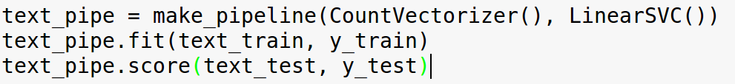
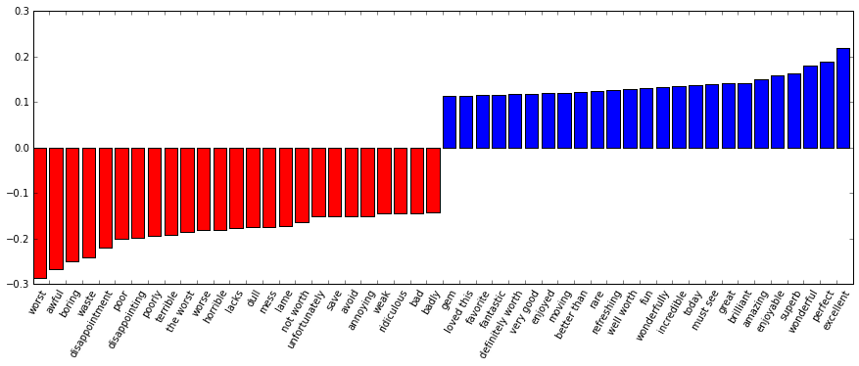

Slide 19
Model Complexity

Slide 20
Overfitting and Underfitting
Training
Sweet spot
Accuracy
Generalization
Underfitting
Overfitting
Model complexity

Slide 21
Model Complexity Examples

Slide 22
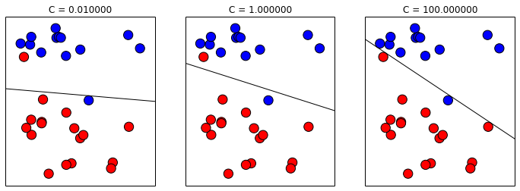
Linear SVM

Slide 23
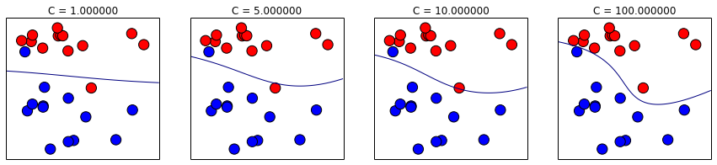
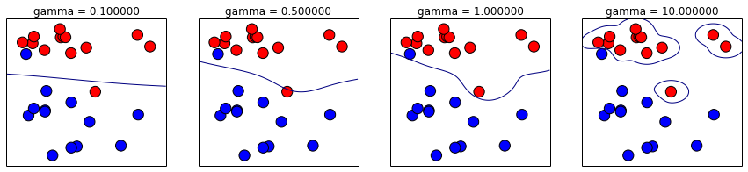
(RBF) Kernel SVM

Slide 24
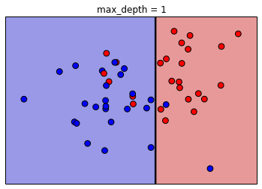
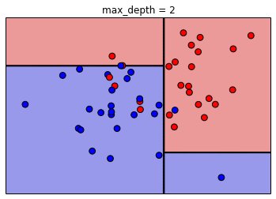
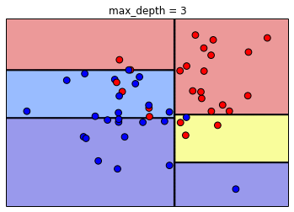
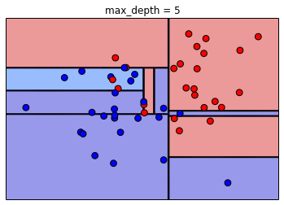
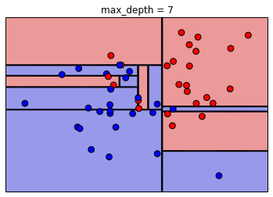
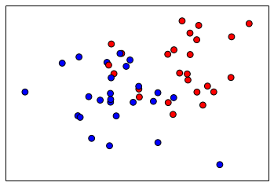
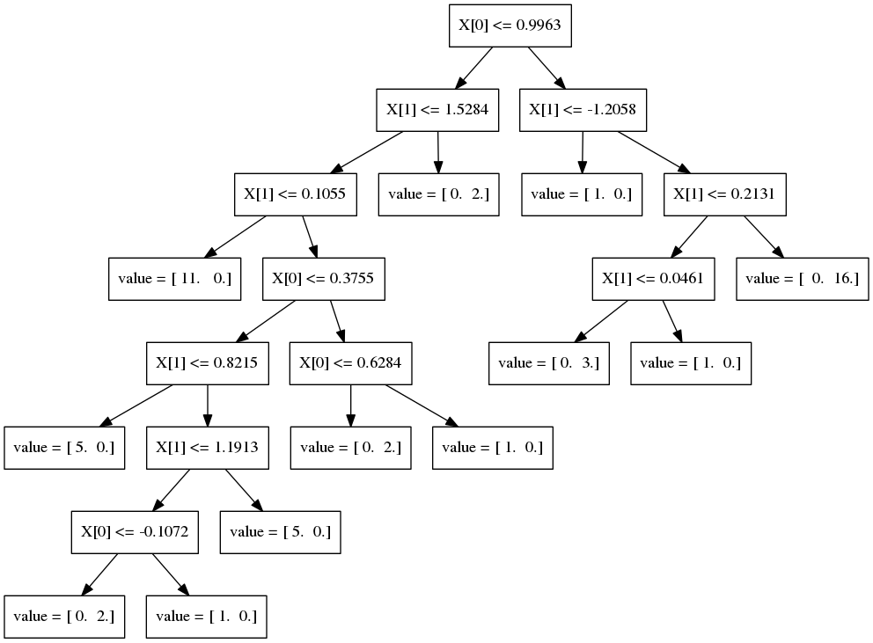
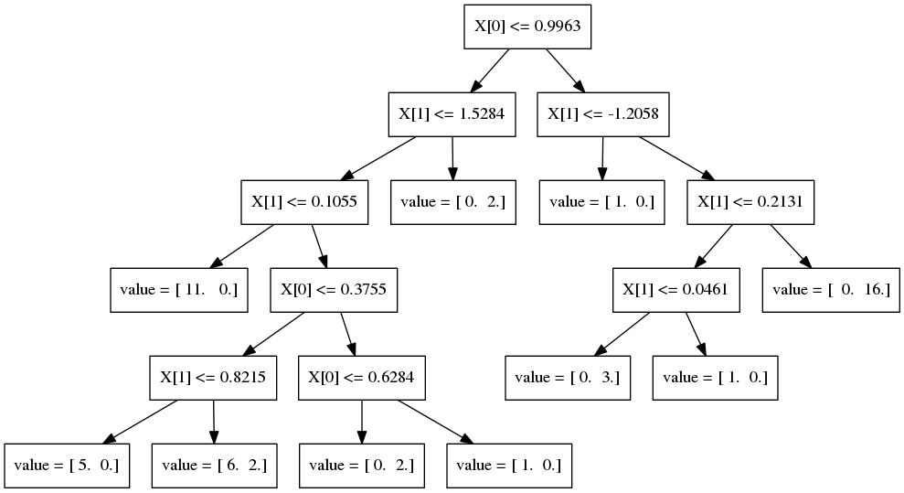
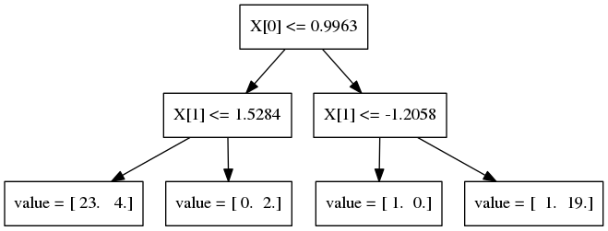
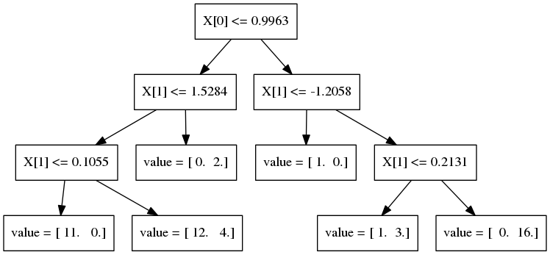
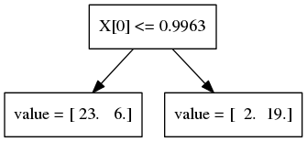
Decision Trees

Slide 25
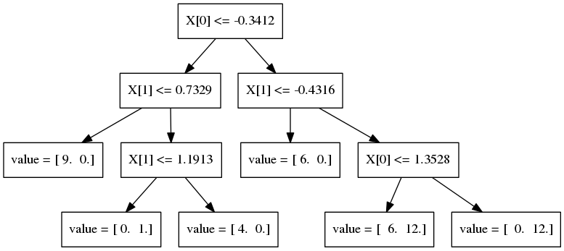
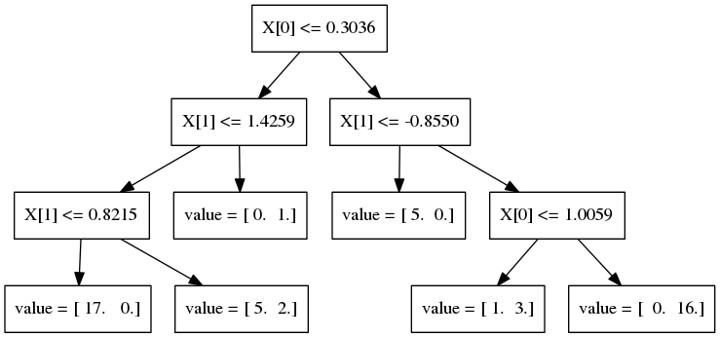
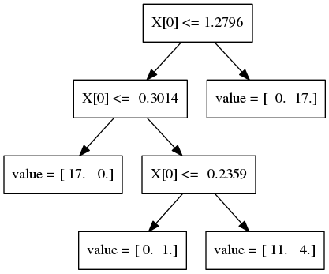
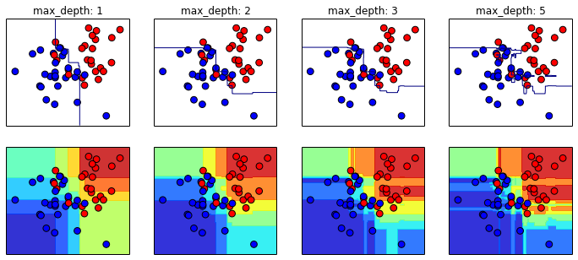
Random Forests

Slide 26
Model Evaluation and Model Selection

Slide 27
All Data
Training data
Test data
Fold 1
Fold 2
Fold 3
Fold 4
Fold 5
Split 1
Fold 1
Fold 2
Fold 3
Fold 4
Fold 5
Split 2
Fold 1
Fold 2
Fold 3
Fold 4
Fold 5
Split 3
Fold 1
Fold 2
Fold 3
Fold 4
Fold 5
Split 4
Fold 1
Fold 2
Fold 3
Fold 4
Fold 5
Split 5
Fold 1
Fold 2
Fold 3
Fold 4
Fold 5

Slide 28
Cross-Validation
from sklearn.cross_validation import cross_val_score
scores = cross_val_score(SVC(), X, y, cv=5)
print(scores)
>> [ 0.92 1. 1. 1. 1. ]

Slide 29
SVC(C=0.001, gamma=0.001)
SVC(C=0.01, gamma=0.001)
SVC(C=0.1, gamma=0.001)
SVC(C=1, gamma=0.001)
SVC(C=10, gamma=0.001)
SVC(C=0.001, gamma=0.01)
SVC(C=0.01, gamma=0.01)
SVC(C=0.1, gamma=0.01)
SVC(C=1, gamma=0.01)
SVC(C=10, gamma=0.01)
SVC(C=0.001, gamma=0.1)
SVC(C=0.01, gamma=0.1)
SVC(C=0.1, gamma=0.1)
SVC(C=1, gamma=0.1)
SVC(C=10, gamma=0.1)
SVC(C=0.001, gamma=1)
SVC(C=0.01, gamma=1)
SVC(C=0.1, gamma=1)
SVC(C=1, gamma=1)
SVC(C=10, gamma=1)
SVC(C=0.001, gamma=10)
SVC(C=0.01, gamma=10)
SVC(C=0.1, gamma=10)
SVC(C=1, gamma=10)
SVC(C=10, gamma=10)

Slide 30
All Data
Training data
Test data
Fold 1
Fold 2
Fold 3
Fold 4
Fold 5
Split 1
Fold 1
Fold 2
Fold 3
Fold 4
Fold 5
Split 2
Fold 1
Fold 2
Fold 3
Fold 4
Fold 5
Finding Parameters
Split 3
Fold 1
Fold 2
Fold 3
Fold 4
Fold 5
Split 4
Fold 1
Fold 2
Fold 3
Fold 4
Fold 5
Split 5
Fold 1
Fold 2
Fold 3
Fold 4
Fold 5
Final evaluation
Test data

Slide 31
Cross -Validated Grid Search
from sklearn.grid_search import GridSearchCV
from sklearn.cross_validation import train_test_split
X_train, X_test, y_train, y_test = train_test_split(X, y)
param_grid = {'C': 10. ** np.arange(-3, 3),
'gamma': 10. ** np.arange(-3, 3)}
grid = GridSearchCV(SVC(), param_grid=param_grid)
grid.fit(X_train, y_train)
grid.predict(X_test)
grid.score(X_test, y_test)

Slide 32
Training Labels
Training Data
Model

Slide 33
Training Labels
Training Data
Feature
Extraction
Scaling
Feature
Selection
Model
Cross Validation

Slide 34
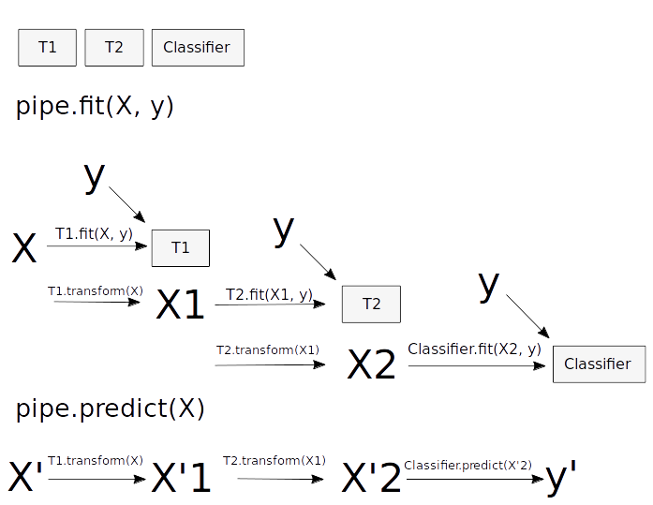
Pipelines
from sklearn.pipeline import make_pipeline
pipe = make_pipeline(StandardScaler(), SVC())
pipe.fit(X_train, y_train)
pipe.predict(X_test)

Slide 35
Combining Pipelines and
Grid Search
Proper cross-validation
param_grid = {'svc__C': 10. ** np.arange(-3, 3),
'svc__gamma': 10. ** np.arange(-3, 3)}
scaler_pipe = make_pipeline(StandardScaler(), SVC())
grid = GridSearchCV(scaler_pipe, param_grid=param_grid, cv=5)
grid.fit(X_train, y_train)

Slide 36
Combining Pipelines and
Grid Search II
Searching over parameters of the preprocessing step
param_grid = {'selectkbest__k': [1, 2, 3, 4],
'svc__C': 10. ** np.arange(-3, 3),
'svc__gamma': 10. ** np.arange(-3, 3)}
scaler_pipe = make_pipeline(SelectKBest(), SVC())
grid = GridSearchCV(scaler_pipe, param_grid=param_grid, cv=5)
grid.fit(X_train, y_train)

Slide 37
Do cross-validation over all steps jointly.
Keep a separate test set until the very end.

Slide 38
Randomized Parameter Search

Slide 39
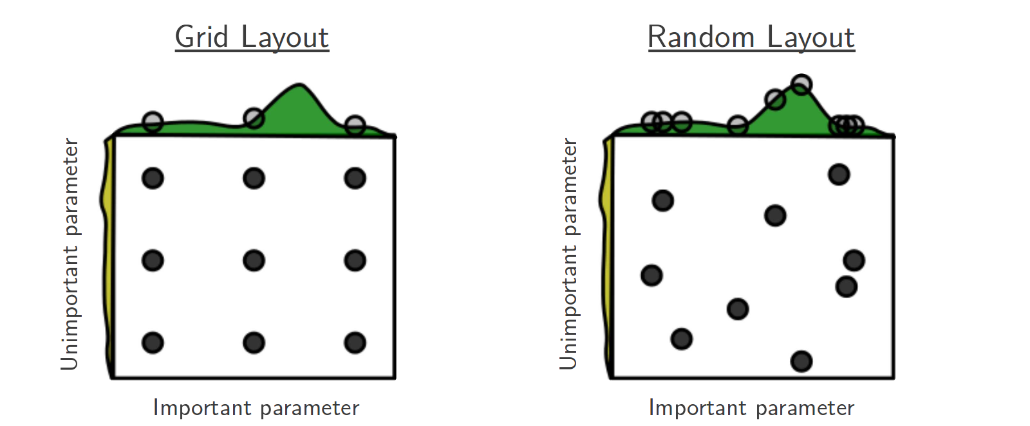
Randomized Parameter Search
Step-size free for continuous parameters
Decouples runtime from search-space size
Robust against irrelevant parameters
Source: Bergstra and Bengio

Slide 40
Scoring Functions

Slide 41
GridSeachCV
RandomizedSearchCV
cross_val_score
Default:
Accuracy (classification)
R2 (regression)
For GridSeachCV
cross_val_score
validation_curve
Typical: accuracy

Slide 42
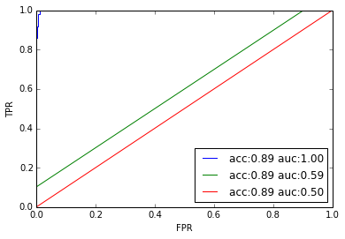
Scoring with imbalanced data
cross_val_score(SVC(), X_train, y_train)
>>> array([ 0.9, 0.9, 0.9])
cross_val_score(DummyClassifier("most_frequent"), X_train, y_train)
>>> array([ 0.9, 0.9, 0.9])
cross_val_score(SVC(), X_train, y_train, scoring="roc_auc")
>>> array([ 1,0, 1.0, 1,0])

Slide 43
Scaling Up

Slide 44
Three regimes of data
Fits in RAM
Fits on a Hard Drive
Doesn't fit on a single PC

Slide 45
Three regimes of data
Fits in RAM (up to 256 GB?)
Fits on a Hard Drive (up to 6TB?)
Doesn't fit on a single PC

Slide 46
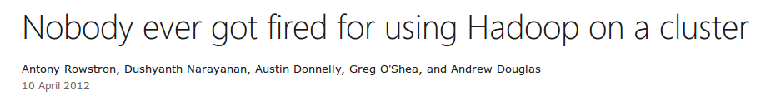

Slide 47
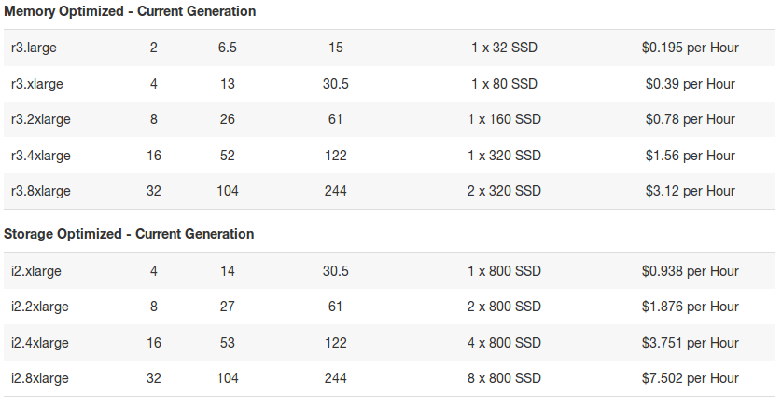

Slide 48
"256Gb ought to be enough for anybody."
- me
(for machine learning)

Slide 49
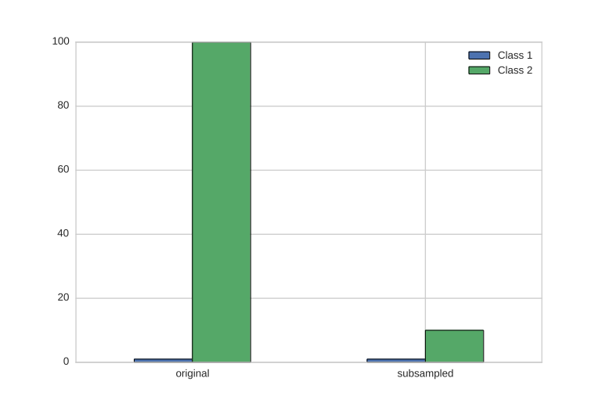
Subsample!

Slide 50
The scikit-learn way

Slide 51
HDD
Your for-loop / polling
estimator.partial_fit(X_batch, y_batch)
Trained
Scikit-learn
estimator
Network

Slide 52
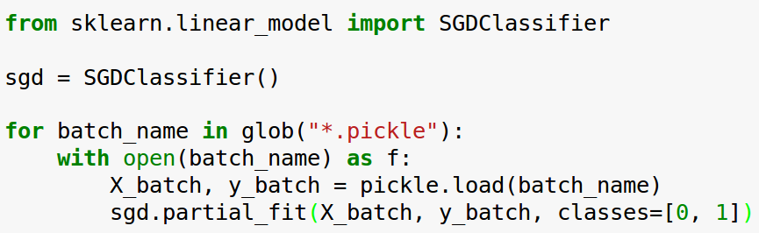
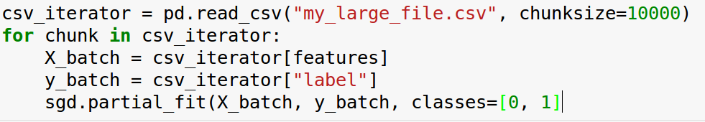
Linear Classification

Slide 53
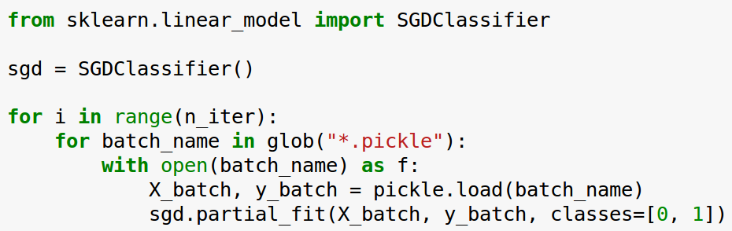
Linear Classification

Slide 54
Text Classification: Bag Of Word
“This is how you get ants.”
tokenizer
['this', 'is', 'how', 'you', 'get', 'ants']
Build a vocabulary over all documents
['aardvak', 'amsterdam', 'ants', ... 'you', 'your', 'zyxst']
Sparse matrix encoding
aardvak
ants
get
you
zyxst
[0, …, 0, 1, 0, … , 0, 1 , 0, …, 0, 1, 0, …., 0 ]

Slide 55
Text Classification: Hashing Trick
“This is how you get ants.”
tokenizer
['this', 'is', 'how', 'you', 'get', 'ants']
hashing
[hash('this'), hash('is'), hash('how'), hash('you'), hash('get'), hash('ants')]
= [832412, 223788, 366226, 81185, 835749, 173092]
Sparse matrix encoding
aardvak
ants
get
you
zyxst
[0, …, 0, 1, 0, … , 0, 1 , 0, …, 0, 1, 0, …., 0 ]

Slide 56
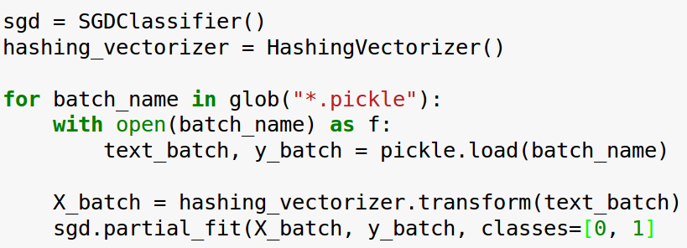
Text Classification: Hashing Trick

Slide 57
Supported Algorithms
All SGDClassifier derivatives
Naive Bayes
MinibatchKMeans
IncrementalPCA
MiniBatchDictionaryLearning

Slide 58
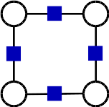
PyStruct
Structured Prediction in Python

Slide 59
Structured Prediction

Slide 60
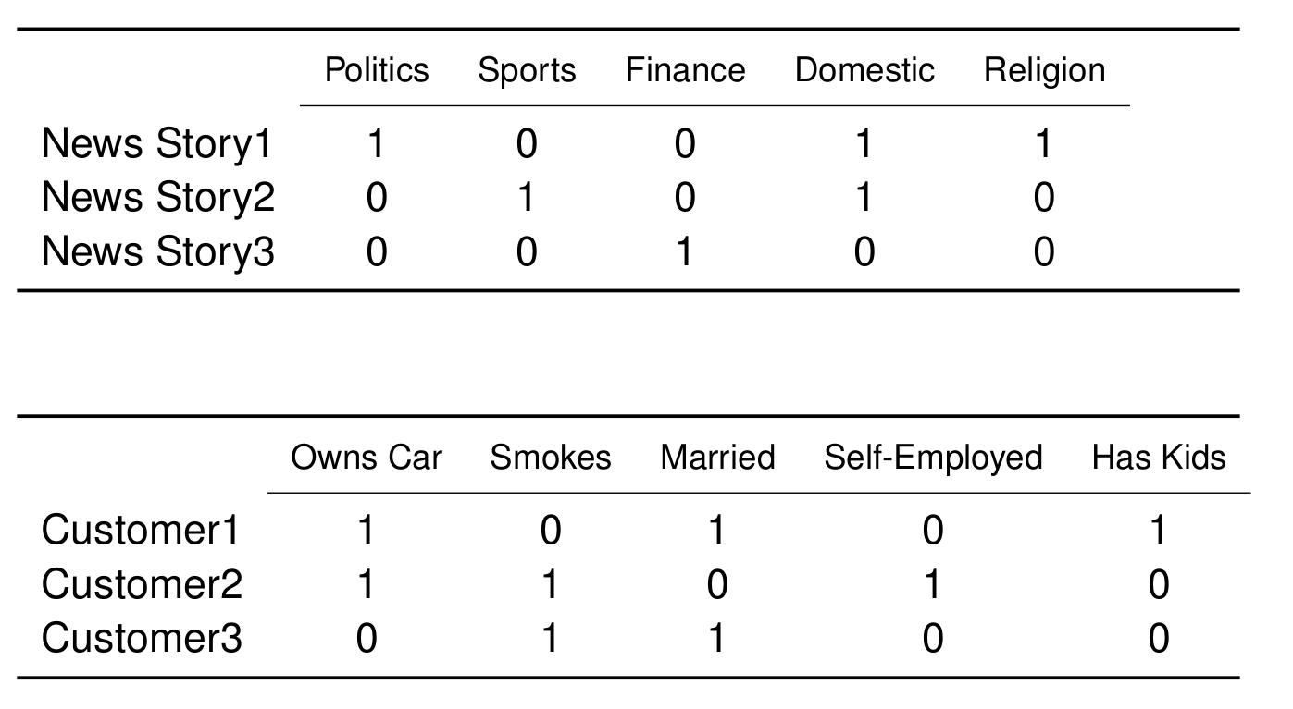
Applications: Multi-Label Classification

Slide 61
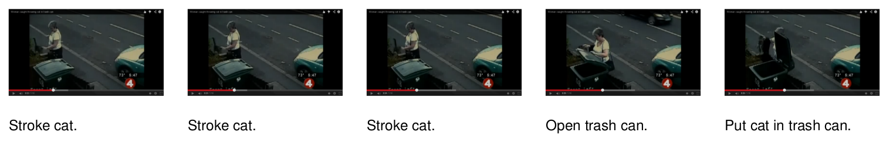
Applications: Sequence Tagging

Slide 62
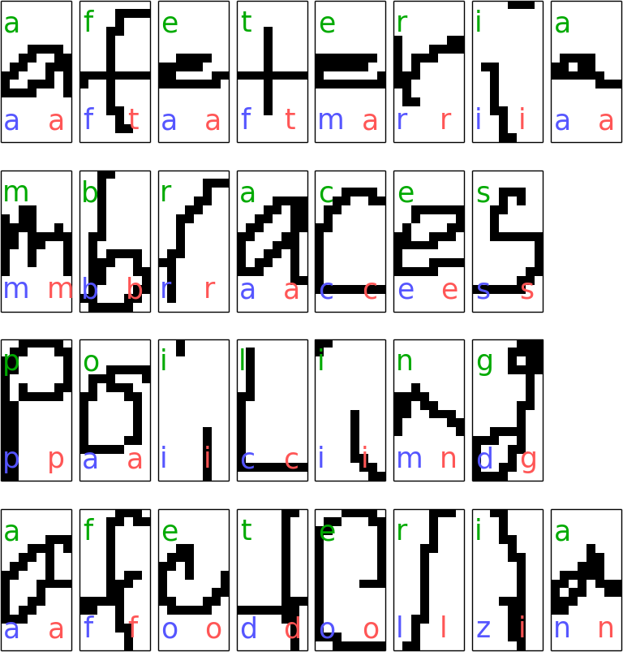
Sequence Tagging example
c
e
s
c
model = ChainCRF()
ssvm = OneSlackSSVM(model=model, C=.1)
ssvm.fit(X_train, y_train)

Slide 63
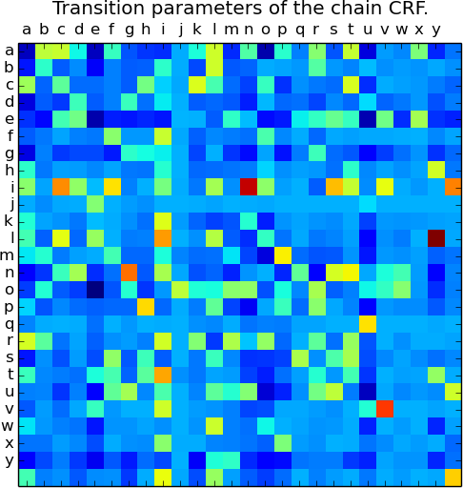
Sequence Tagging example
c
e
s
c
model = ChainCRF()
ssvm = OneSlackSSVM(model=model, C=.1)
ssvm.fit(X_train, y_train)

Slide 64
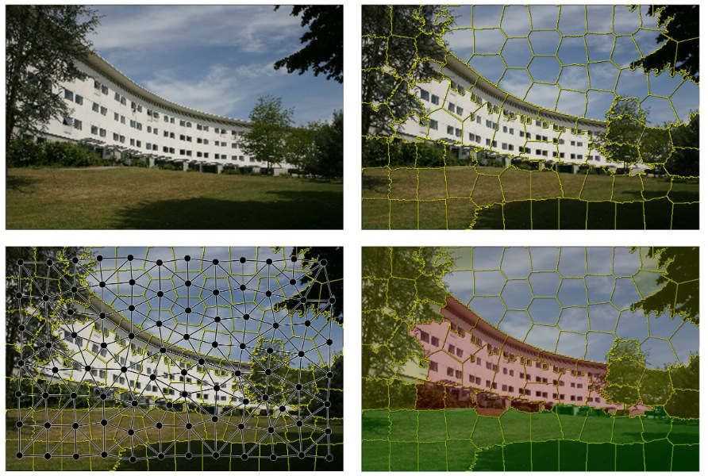

Slide 65
AutoML: The Future?

Slide 66
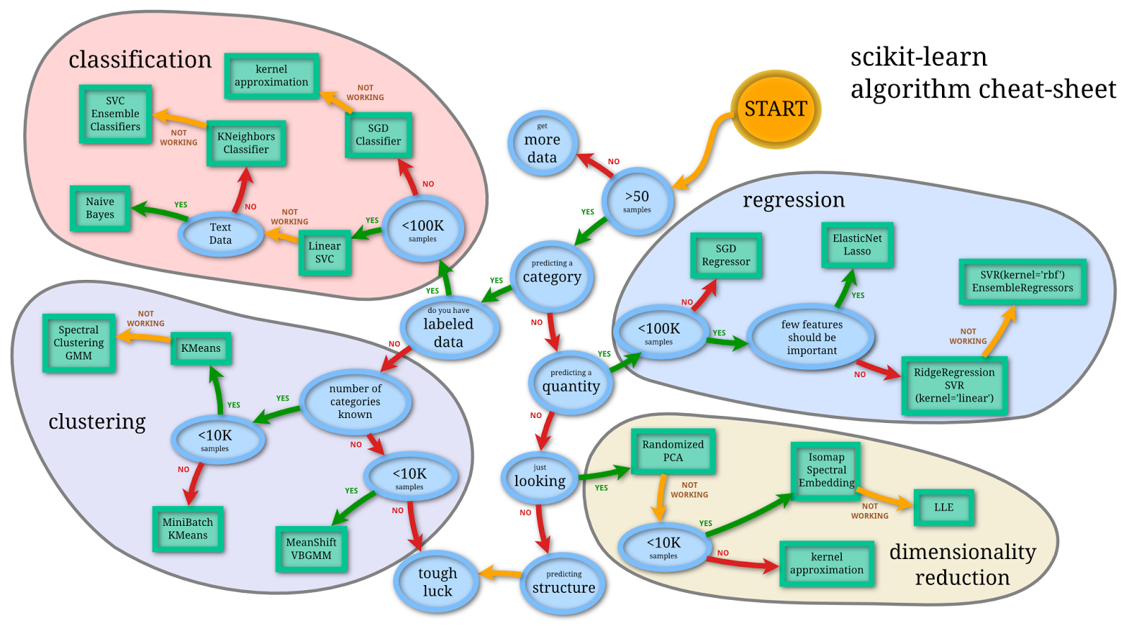

Slide 67
Search over Models, not Parameters

Slide 68
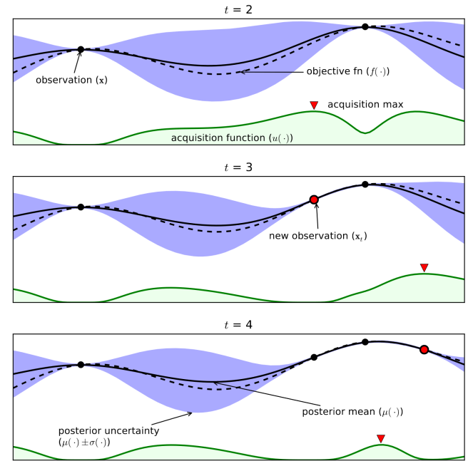
Bayesian Optimization
From Eric Brochu, Vlad M. Cora and Nando de Freitas

Slide 69
Meta-Learning:
Predict which model to use from Meta-Features
see: auto-sklearn

Slide 70
Upcoming Video Series:
Advanced Machine Learning with scikit-learn

Slide 71
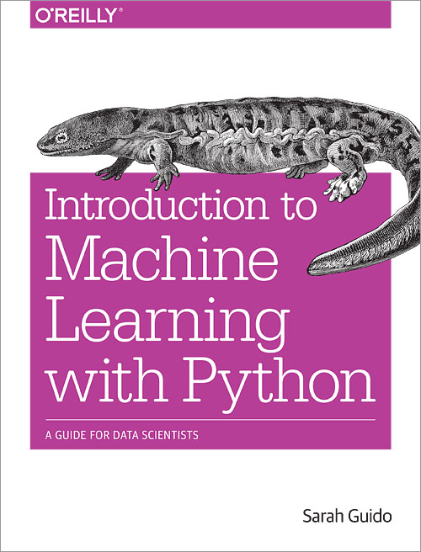

Slide 72




Thank you for your attention.
@t3kcit
@amueller
importamueller@gmail.com
http://amueller.github.io

